Slide 1


Can AI Catch Bugs Your Compiler Can't?
Java & Spring Boot bugs that compile clean, pass every test, and still break production
Shreeprabha N
linkedin.com/in/shreeprabha-n
github.com/shreeprabha1217/HackersMang
Notes:
Open with energy. State the premise in one line before the title even lands: "compiles and passes tests" is not the same as "correct." Introduce yourself briefly, then move straight to the agenda.

Slide 2
@hackersmang #HMSep26
30 minutes, four stops
01
The premise : compiled and tested isn't the same as correct
3 min
02
Where reviews and unit tests quietly let bugs through
5 min
03
Three live demos : race condition, @Transactional proxy, N+1 queries
18 min
04
Limits of AI review, takeaways, and how to start using it
4 min

Slide 3




@hackersmang #HMSep26
Code that compiles and passes tests need not be perfect
The compiler checks syntax and types. Your test suite checks the cases you thought to write. Neither one is looking for the bugs that only show up under load, under bad data, or under Spring's own plumbing.
Timing-dependent
Framework-shaped
Volume-dependent
Adversarial
Race conditions and concurrency bugs only surface under real, simultaneous load.
Proxy-based mechanics like @Transactional fail silently, with no exception raised.
N+1 queries look correct with 3 test rows and fall over with 3,000 real ones.
Security vulnerabilities need someone actively trying to break the code.
Unhandled exceptions
Race conditions
Concurrency bugs
Inefficient database access
Missing edge cases
Security vulnerabilities

Slide 4

@hackersmang #HMSep26
Who actually catches what
Bug class | Compiler | Unit tests | AI review
Unhandled exceptions | No | Sometimes | Yes
Race conditions | No | Rarely | Yes
@Transactional proxy bypass | No | Rarely | Yes
N+1 queries | No | Rarely | Yes
Security vulnerabilities | No | Sometimes | Yes
Today's three demos live in the middle rows : invisible until a specific timing, a specific proxy call, or a specific data volume exposes them.

Slide 5




@hackersmang #HMSep26
github.com/shreeprabha1217/HackersMang
LIVE DEMO 1 / 3 : RACE CONDITION
Fixed with atomics
count = count + 1, called concurrently, with no lock and no atomic type. It compiles. It passes every single-threaded test. Under real concurrency, updates get lost.
The bug
What AI flags
Live now
A shared counter, read-modify-write, no synchronization. Two threads read the same value; one update vanishes.
Non-atomic increment on shared state. Suggests AtomicInteger, synchronized, or an atomic UPDATE at the database.
Fire 1000 increments from 10 threads : watch the final count come up short.
count = count + 1;
count.incrementAndGet();
Notes:
Hard to prove live because it's timing-dependent : either run the multi-threaded harness live, or lean on the AI explaining why it's unsafe if the repro doesn't cooperate on stage.

Slide 6
@hackersmang #HMSep26
github.com/shreeprabha1217/HackersMang
LIVE DEMO 2 / 3 : TRANSACTIONAL PROXY
@Transactional bypassing its own proxy
A method calls another @Transactional method on "this", inside the same class. Spring's transactional advice silently never fires : no exception, no warning.
The bug
What AI flags
Live now
this.saveOrder() skips the Spring proxy entirely, so the @Transactional boundary is never applied.
Self-invocation of an annotated method, and why the proxy mechanism means the annotation is silently ignored.
Throw an exception right after saveOrder() : the "rolled back" order stays in the database.
this.saveOrder(order);
split beans, or AopContext.currentProxy()
Notes:
Ask the AI to explain WHY it doesn't work, not just to find it : the proxy explanation is the educational payoff for the room. Strongest "aha" of the three.

Slide 7
@hackersmang #HMSep26
github.com/shreeprabha1217/HackersMang
LIVE DEMO 3 / 3 : N+1 QUERIES
The N+1 query problem
A lazy-loaded JPA collection, accessed inside a loop. One query becomes N+1 : invisible in code review, obvious the moment you look at the SQL log.
The bug
What AI flags
Live now
order.getItems() inside a loop triggers one lazy-load query per order : 1 query becomes 201.
Lazy association accessed in a loop. Suggests JOIN FETCH, @EntityGraph, or a DTO projection.
Seed 200 orders, turn on SQL logging, and count the queries a "passing" test actually runs.
for (Order o : orders) o.getItems(); → 201 queries
join fetch o.items → 1 query
Notes:
Easiest of the three to prove live: turn on Hibernate SQL logging (show-sql or p6spy) and show the query count drop from 201 to 1.

Slide 8


@hackersmang #HMSep26
AI review is not magic
It's an extra pair of eyes, not an oracle : treat every finding as a lead worth checking, not a verdict.
False positives happen
Results aren't deterministic
Prompting matters
It can flag safe code as risky, especially with limited context on the surrounding system. Every suggestion still needs a human judgment call.
The same prompt can catch a bug on one run and miss it on the next. Don't stake a live demo on a single pass : have a fallback.
A generic "review this" finds less than a targeted "check for race conditions and thread safety." How you ask shapes what it finds.
Treat it the way you'd treat a junior reviewer's comment: worth a look, never worth a merge on its own.

Slide 9


@hackersmang #HMSep26
Three takeaways
Use AI review as an extra pass, not a replacement : it works alongside your compiler, tests, and human reviewers.
Target your prompts at bug classes tests miss : concurrency, framework proxies, query patterns : rather than a generic review.
Let it generate the tests you'd otherwise skip : the edge cases and failure paths are exactly where it's most useful.
Three demos, three bug classes your compiler and tests both waved through. That's the case for adding this layer.

Slide 10
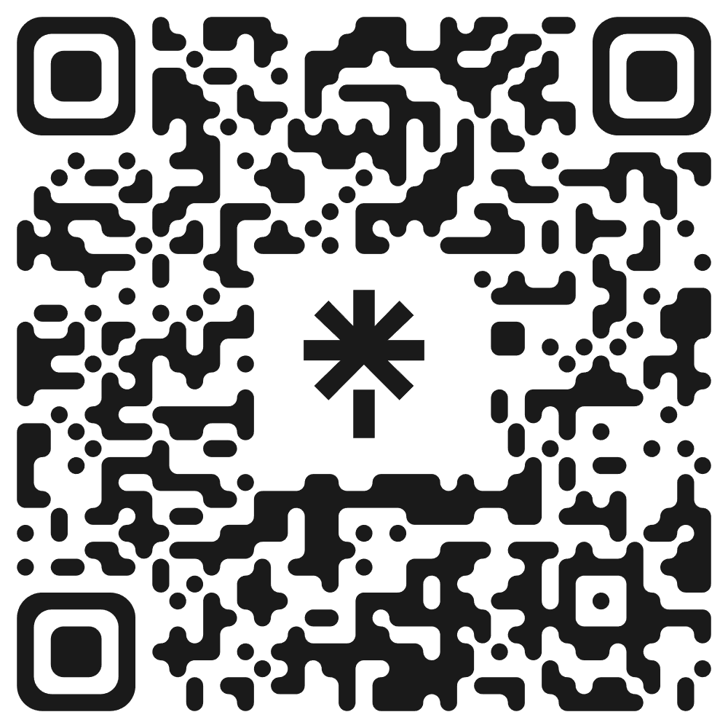
Stay Connected with @hackersmang
#HMSep26

